Slide 1
3. Supervised Learning (II) – application to natural language processing (NLP)
IT348/448

Slide 2
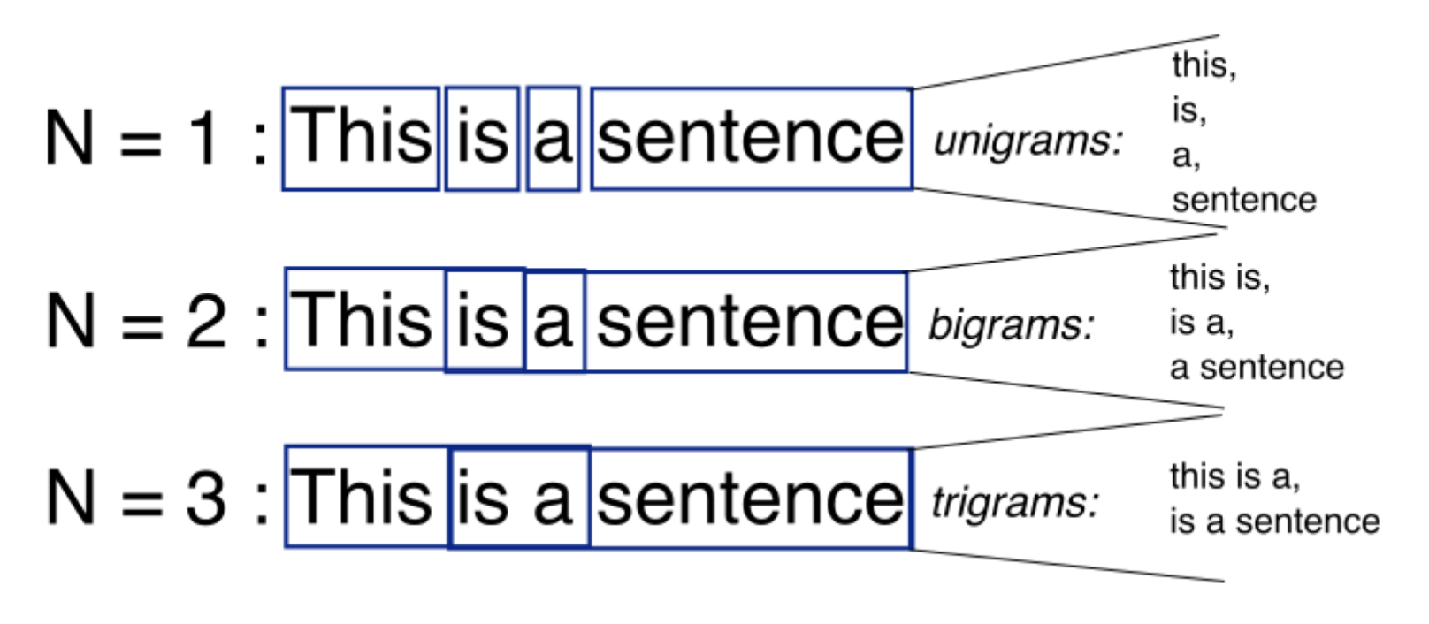
N-grams
N-grams: a continuous sequence of n tokens

Slide 3
Google books ngram viewer
http://books.google.com/ngrams

Slide 4
Bag-of-words model
Used when modelling documents
Feature (or attribute)
Unigram
Bigram

Slide 5
The Bag of Words Representation

Slide 6
Text Classification/categorization
Input:
a document d
a fixed set of classes C = {c₁, c₂,…, c_{J}}
Output: a predicted class c ∈ C for a new document
6

Slide 7
Classification Methods: Hand-coded rules
Rules based on combinations of words or other features
spam: black-list-address OR (“dollars” AND “have been selected”)
Accuracy can be high
If rules carefully refined by expert
But building and maintaining these rules is expensive
7

Slide 8
Supervised Machine Learning
Input:
a document d
a fixed set of classes C = {c₁, c₂,…, c_{J}}
A training set of m hand-labeled documents (d₁,c₁),....,(d_{m},c_{m})
Output:
a learned classifier d → c
8

Slide 9
Naïve Bayes Intuition
Simple (“naïve”) classification method based on Bayes rule
Relies on very simple representation of document
Bag of words
9

Slide 10
The Bag of Words Representation

Slide 11
Naïve Bayes Classifier (I)
MAP is “maximum a posteriori” = most likely class
Bayes Rule
Dropping the denominator
11

Slide 12
Naïve Bayes Classifier (II)
Document d represented as features x₁..x_{n}
How often does this class occur?
We can just count the relative frequencies in a corpus
12

Slide 13
Naïve Bayes Independence Assumptions
Bag of Words assumption: Assume position doesn’t matter
Conditional Independence: Assume the feature probabilities P(x_{i}|c_{j}) are independent given the class c.
13

Slide 14
Naïve Bayes Classifier
14

Slide 15
Applying Naive Bayes to Text Classification
positions ← all word positions in test document
15

Slide 16
Learning phase: the Naïve Bayes Model
First attempt: maximum likelihood estimates
Simply use the frequencies in the data
Corpus: a collection of documents, N
16

Slide 17
The Bag of Words Representation

Slide 18
Parameter estimation
fraction of times word w_{i} appears
among all words in documents of topic c_{j}
Create mega-document (or multi-document) for topic j by concatenating all docs in this topic
Use frequency of w in mega-document (i.e., corpus)
18

Slide 19
Problem with Maximum Likelihood
What if we have seen no training documents with the word fantastic and classified in the topic positive?
Zero probabilities cannot be conditioned away, no matter the other evidence!
19

Slide 20
Laplace Smoothing for Naïve Bayes
20

Slide 21
Naïve Bayes and Language Modeling
Naïve bayes classifiers can use any sort of feature, not just the words
URL, email address, dictionaries, network features
But if
We use only word features
And we use all of the words in the text (not a subset)
Then
Naïve bayes has an important similarity to language modeling.
21

Slide 22
Generative Model for Naïve Bayes
c=China
X₁=Shanghai
X₂=and
X₃=Shenzhen
X₄=issue
X₅=bonds
22

Slide 23
 | Doc | Words | Class
Training | 1 | Chinese Beijing Chinese | c
 | 2 | Chinese Chinese Shanghai | c
 | 3 | Chinese Macao | c
 | 4 | Tokyo Japan Chinese | j
Test | 5 | Chinese Chinese Chinese Tokyo Japan | ?
Priors:
P(c)=3/4
P(j)= 1/4
Where N = the number of docs in the given corpus
N_{c} = the number of documents with class C
Choosing a class for a test data point:
P(c|d5)
P(j|d5)
3/4 * (3/7)³ * 1/14 * 1/14
≈ 0.0003
Conditional Probabilities:
P(Chinese|c) =
P(Tokyo|c) =
P(Japan|c) =
P(Chinese|j) =
P(Tokyo|j) =
P(Japan|j) =
(5+1) / (8+6) = 6/14 = 3/7
1/4 * (2/9)³ * 2/9 * 2/9
≈ 0.0001
(0+1) / (8+6) = 1/14
(0+1) / (8+6) = 1/14
(1+1) / (3+6) = 2/9
(1+1) / (3+6) = 2/9
(1+1) / (3+6) = 2/9
V = {Chinese, Beijing, Shanghai, Macao, Tokyo, Japan}; |V| = 6
23

Slide 24
Recall: Naïve Bayes Classifier (I)
MAP is “maximum a posteriori” = most likely class
Bayes Rule
Dropping the denominator
24

Slide 25
Recall: Naïve Bayes Classifier
Document d represented as features x₁..x_{n}
25

